Slide 1
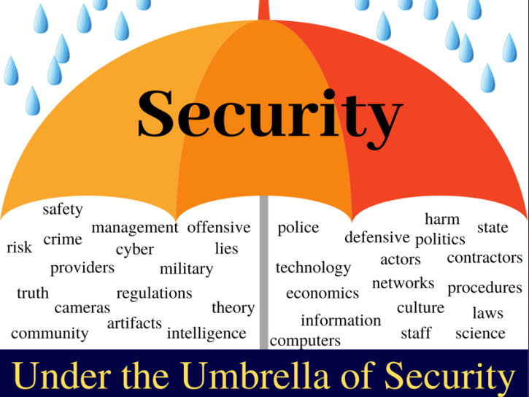

Slide 2
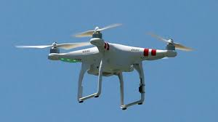

Does Security Even Matter?
Security is “until proven insecure”?
Think bout everyday security:
Cameras, electric gates, doors with swipe cards..
Increased airport security measures
Think: Human Security Guards, full-body scanners, taking off your shoes, etc.
Are we safer because of these measures?
If so, is it worthwhile?
Feeling safer vs. Being safer

Slide 3
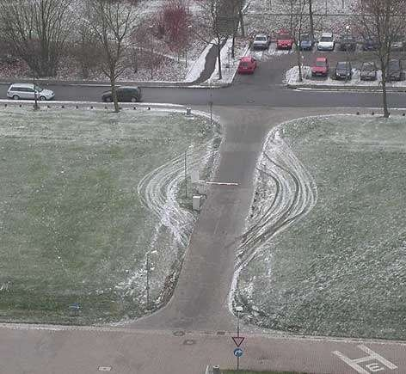
The easiest way to break system security is often to circumvent it rather than defeat it! (as is the case with most software vulnerabilities related to insecure coding practices)
https://wiki.sei.cmu.edu/confluence/display/seccode/Top+10+Secure+Coding+Practices

Slide 4

An Engineer’s Concern
In software engineering you learn how to build software
…but not so much about breaking software!
Part of software security is asking Q’s!!
How do you know that you have built a system that cannot be broken into?
What evidence do you look for?
How do you know you’re done?
How do you prioritise security against everything else that requires your time in the creation of a project?
We need to understand what a vulnerability, an exploit, a threat are..

Slide 5
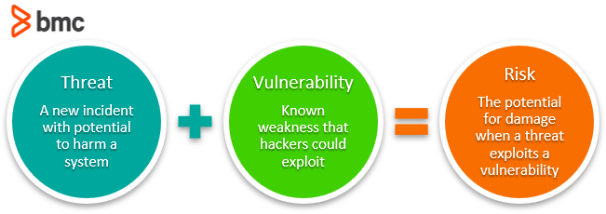
Vulnerability vs. Exploit vs. Threat?
Vulnerability – A weakness in a system
Exploit – a means of using/exploiting a vulnerability
Threat – The risk of the above
A threat is any vulnerability that an be exploited
Risk – the potential for loss or damage when a threat exploits a vulnerability. (Financial, privacy, etc.)
https://www.bmc.com/blogs/security-vulnerability-vs-threat-vs-risk-whats-difference/

Slide 6

Vulnerability
Informally, a bug with security consequences
A design flaw or poor coding that may allow an attacker to exploit software for a malicious purpose
Eg. complete lack of passwords when needed (design flaw)
Eg. allowing easily-guessed passwords (poor coding)
cat V C@t123
50% are coding mistakes, 50% are design flaws (McGraw)
Non-software equivalent to “lack of shoe-examining at the airport”

Slide 7
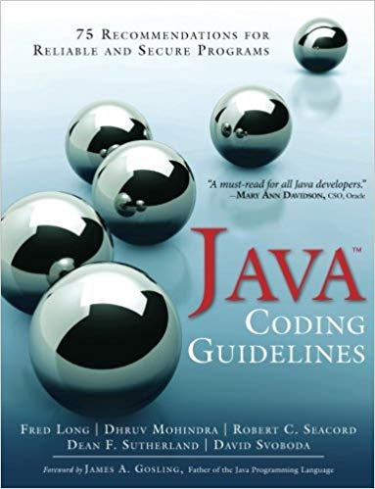
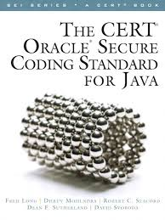
Vulnerability Protection?
How do we protect against vulnerabilities?
Develop secure software!
See link on Blackboard to this book
https://wiki.sei.cmu.edu/confluence/

Slide 8
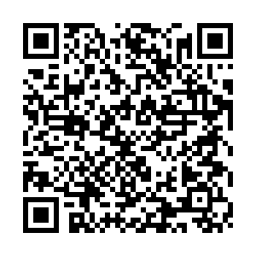
The number of vulnerabilities is…
Increasing, Decreasing, or Stabilising? ?
https://pollev.com/mariagriffin358
Notes:
https://www.polleverywhere.com

Slide 9

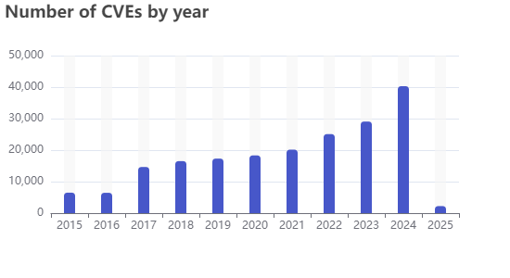
The number of vulnerabilities is…
Increasing!
Companies are being hacked everyday….. Check here
Source: https://www.cvedetails.com/browse-by-date.php
Link : vulnerabilities by type

Slide 10


Discussion: Why is there a growing trend?
Connectivity
The plugged-in generation!
Cloud computing, Internet of Things
Extensibility
Mobile code, devices, open source..
Security Fatigue – companies are growing weary trying to keep up.
Complexity
The more code the more possibility of security issues..
PollEv.com​/mariagriffin779

Slide 11
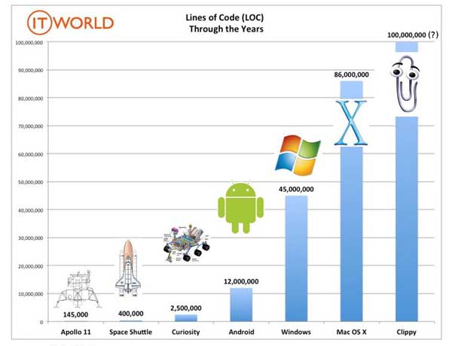
Code Complexity
How Many Millions of Lines of Code Does It Take....?
https://informationisbeautiful.net/visualizations/million-lines-of-code/
What's the Biggest Software Package by Lines of Code?
https://www.itworld.com/article/2725085/curiosity-about-lines-of-code.html

Slide 12
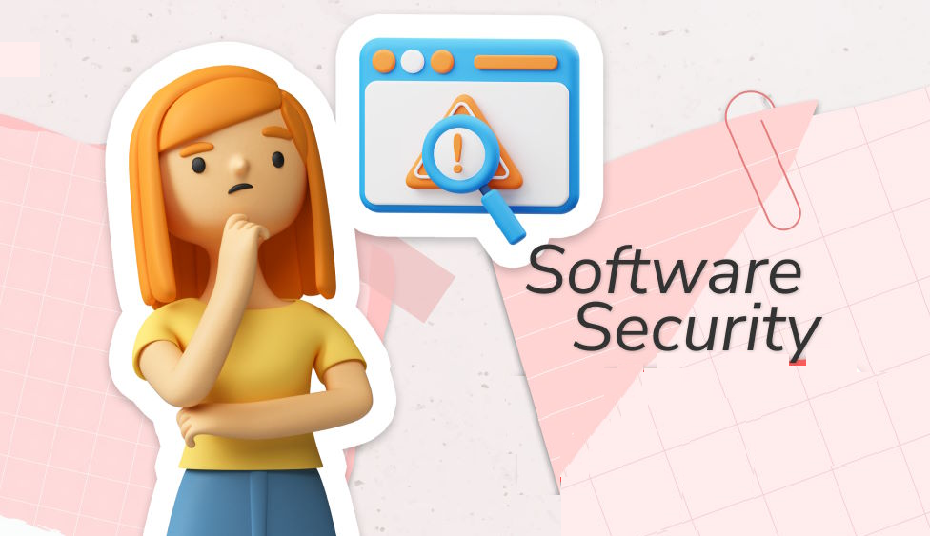
What is Software Security?

Slide 13



Software Security is…
NOT a myth, but a reality
Insecure software causes immeasurable harm…. just read the news
Cybersecurity Statistics and Trends for 2023
HSE Cyberattack : https://www.irishtimes.com/news/crime-and-law/....
Man Utd : https://news.sky.com/story...
News Today!!
Google News

Slide 14

Software Security is…
NOT a secret art form
Much of it seems mysterious
How do hackers find severe vulnerabilities without source code?
How do hackers create the exploit to expose the vulnerability?
How do they come up with all these endless clever ways to break software?
We need to remember :
You (Developers) have much more knowledge than the attackers do
But.. Don’t just leave it to the experts, take responsibility for knowing security

Slide 15
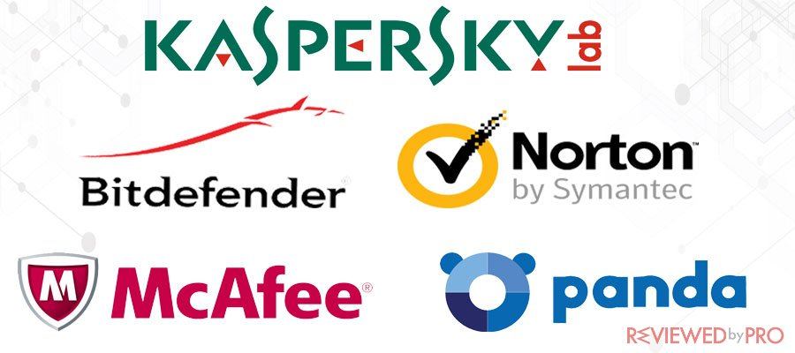
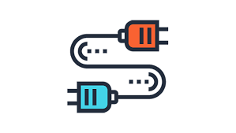
Software Security is…
NOT a set of features
Secure software > Security software
(greater than)
Although tools and experts are helpful,
You can’t just deploy a magical tool and expect all vulnerabilities to disappear
You can’t outsource all of your security knowledge
Even if you are using a security library/API/Plugin, know how to use it properly!

Slide 16


Software Security is…
NOT a problem for just mathematicians
Cryptography /Encryption
Is important and needed
But, it cannot solve all, of your security problems
Padlock lock vs. open door
A lock and security is no good if you leave the back door open!
Need other measures.

Slide 17
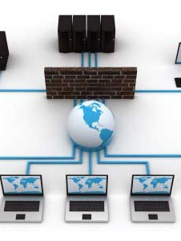
Software Security is…
NOT a problem for just networking and operating systems teams
Software had security problems long before we had the internet

Slide 18

Software Security is…
A reality that everyone must face
Not just developers, all stakeholders, everyone involved in IT projects.
A learnable mindset for software engineers
The ability to prevent unintended functionality
In all parts of your system
BUILDING SECURITY IN!

Slide 19
Why do we need to talk about security?
Everyone know you filter input
Everyone knows you use https or some other magic cryptography
Everyone knows you use prepared statements
Everyone knows you apply security patches to your system.
Everyone knows as long and you are GDPR and PCI compliant you are safe
Everyone know that a firewall blocks everything
But… Everyone is stupid! “to err is human”

Slide 20
Summary.. Security is not…
A feature at the end of a project
Meeting a compliance checklist
A single person or teams job
Hiring someone to do it afterward
A tools or application

Slide 21
Summary… Security is…
An ongoing process
A paranoid way of thinking
Acknowledging that you will be hacked at some point
Habit
Everybody’s problem

Slide 22

Java designed for security
The Java language is designed to be type-safe and easy to use.
It provides
automatic memory management,
garbage collection, and
range-checking on arrays.
This reduces the overall programming burden placed on developers, leading to less programming errors and moving to safer, more robust code.

Slide 23
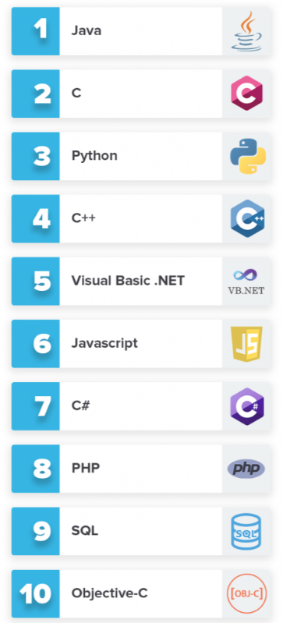
Why are we looking at Java?
Java has been prevalent to lots of vulnerabilities
It is easier for practice to see issues
No constrains - Open source
It’s what’s being used most in industry
Also the language that you are most familiar with!
Top 10 Java Vulnerabilities And How To Fix Them

Slide 24
Summary
There are all sorts of explicit security tools - cryptography, authentication and others, but most ‘break-ins’ are exploitations of bugs, that is code that was badly written or that was insufficiently defensive.
Security is not a feature, it is an attitude toward taking due care at every point.
Security should be a continuous part of every software engineer’s design thought process.
It is organised around a list of guidelines.

Slide 25
Vulnerability Protection?
How do we protect against vulnerabilities?
Develop secure software!
See link on Blackboard to this book
https://wiki.sei.cmu.edu/confluence/

Slide 26

Practical/Lab
See Blackboard for details of this weeks Lab work
You will need:
Java
VS Code (or other IDE)
Local Database
I will also go over the CA

